Slide 1

Ideal Solution V-L Calculations
Bernie Tao

Slide 2
Learning objectives
Understand Raoult’s law with regards to vapor-liquid equilibrium compositions
Be able to use Raoult’s law to generate P-x and T-x phase diagrams
Be able to calculate bubble pressure/temperature and dew pressure/temperature using Raoult’s law
Understand the concept of the partitioning ratio
Understand the modified Raoult’s law

Slide 3
V-L equilibrium
At phase equilibrium, μ_{i}^{V}= μ_{ι}^{L}
dμ_{i}= RT d ln(f_{i}) dμ_{i}^{V}= RT d ln(f_{i}^{V})
dμ_{i}^{L}= RT d ln(f_{i}^{L})
Integrating,
μ_{i}^{L} - μ_{i,pure} = RT ln(f_{i}^{L}/ f_{i}) and μ_{i}^{V} - μ_{i,pure} = RT ln(f_{i}^{V}/ f_{i})
Taking the difference and cleaning up similar terms,
μ_{i}^{L} - μ_{i}^{V} = RT {ln(f_{i}^{L}/ f_{i}) - ln(f_{i}^{V}/ f_{i})} = RT ln (f_{i}^{L}/(f_{i}^{V}) = 0
So, equilibrium implies that
f_{i}^{V} = f_{i}^{L}

Slide 4
V-L equilibrium
To calculate the composition phase envelopes of vapor-liquid solutions we start with the basic definition of V-L equilibrium,
f_{i}^{V} = f_{i}^{L}
for ideal solutions, we can use the Lewis-Randall rule,
f_{i}^{α} = x_{i} f_{i}^{α}
so,
y_{i} f_{i}^{V} = x_{i} f_{i}^{L}
Nomenclature
y_{i} x_{i} - mole fraction in gas mixture and liquid solution, respectively
f_{i}^{α} - pure component fugacity in α phase
f_{i}^{α} - partial molar component fugacity in α phase

Slide 5
V-L equilibrium
f_{i}^{V} can be calculated using the definition of the pure component fugacity
f_{i}^{V} = φ_{i} P
The liquid state fugacity, f_{i}^{L}, can be calculated using the Poynting correction at saturate conditions (indicated by *)
f_{i}^{L} = φ_{i}* P_{i}* exp{V_{i}^{L} (P-P_{i}*)/RT}
plugging these into the equilibrium definition
y_{i} φ_{i} P = x_{i} φ_{i}* P_{i}* exp{V_{i}^{L} (P-P_{i}*)/RT}

Slide 6
Raoult’s law
If the Poynting correction is equal to unity (near standard conditions) and the fugacity coefficients are equal (saturated conditions are similar to mixture conditions), this expression simplifies to Raoult’s law,
y_{i} P = x_{i} P_{i}*
Using Raoult’s law and the definition of the mole fraction,
Σy_{i} = 1 = Σ x_{i} P_{i}*/P
Σx_{i} = 1 = Σ y_{i} P/P_{i}*
For binary systems, these become
P = x₁ P₁* + x₂ P₂*
P = 1 .
y₁/P₁* + y₂/P₂*
These equations, along with vapor pressure equations, can be used to generate V-L composition phase diagrams.

Slide 7
Generating binary phase composition diagrams (Raoult’s law, Antoine equation)
Pressure-composition diagram at fixed T
y_{i} = x_{i} P_{i}*/P
ln P* = A - B/(C+T)
liquid
P*₁
P
1. Given T, calculate the vapor pressures for each component P*₁ and P*₂ using Antoine eqn.
P*₂
vapor
2. Select a value of P and calculate the liquid composition P = (P*₁ - P*₂ ) x₁ + P*₂ or
x₁ = (P - P*₂)/(P*₁ - P*₂ )
x₁=0
x₁
y₁
x₁=1
3. Calculate y₁= x₁ P₁*/P
4. Repeat for other values of P and generate liquid and vapor composition-pressure curves.

Slide 8
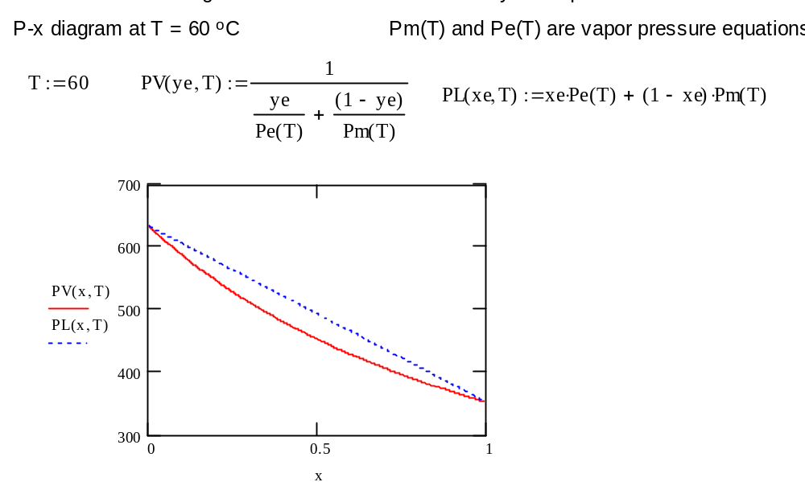

Slide 9
Generating binary phase composition diagrams (Raoult’s law, Antoine equation)
Temperature-composition diagram at fixed P
y_{i} = x_{i} P_{i}*/P
T* = B/(A- ln P*) -C
vapor
T*₂
T
1. Given P, calculate the saturation temperatures for each pure component T*₁ and T*₂ using Antoine eqn.
T*₁
2. Select a value of T and calculate the vapor pressures of each component P*₁(T) and P*₂(T) using Antoine’s eqn.
Calculate x₁ = [P - P*₂(T)]/[P*₁(T) - P*₂(T)]
liquid
x₁=0
x₁=1
x₁
y₁
3. Calculate y₁= x₁ P₁*/P
4. Repeat for other values of P and generate liquid and vapor composition-pressure curves.

Slide 10
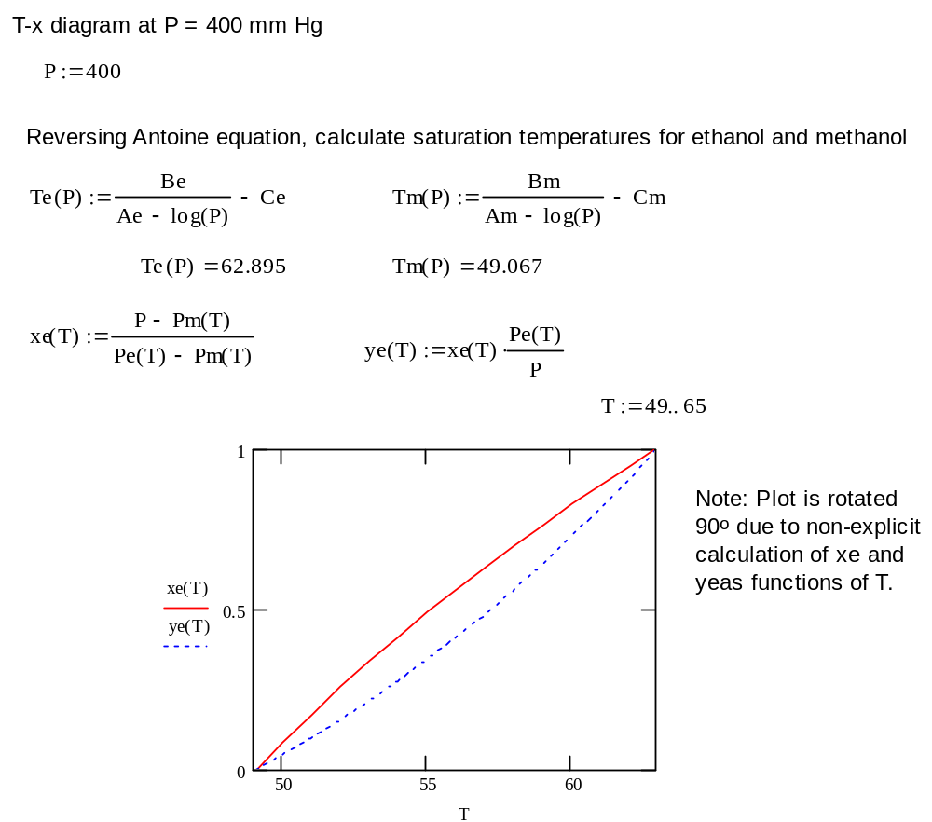

Slide 11
Direct V-L calculations
Often, practical V-L problems involve calculating the T or P conditions, given the liquid or vapor composition. This information could be obtained by generating a V-L composition diagram, but if a single value is needed, this is a lot of work.
Instead, it is possible to re-arrange the calculations equations to directly obtain P and T, given x.

Slide 12
Bubble pressure, binary system
Given x_{i} and T, calculate the total pressure.
1. Use Antoine eqn. to calculate vapor pressures P₁* and P₂* at T.
2. P = x₁ P₁* + x₂ P₂*
Note that in this situation, P is the pressure at which liquid first evaporates, i.e. the bubble pressure.

Slide 13
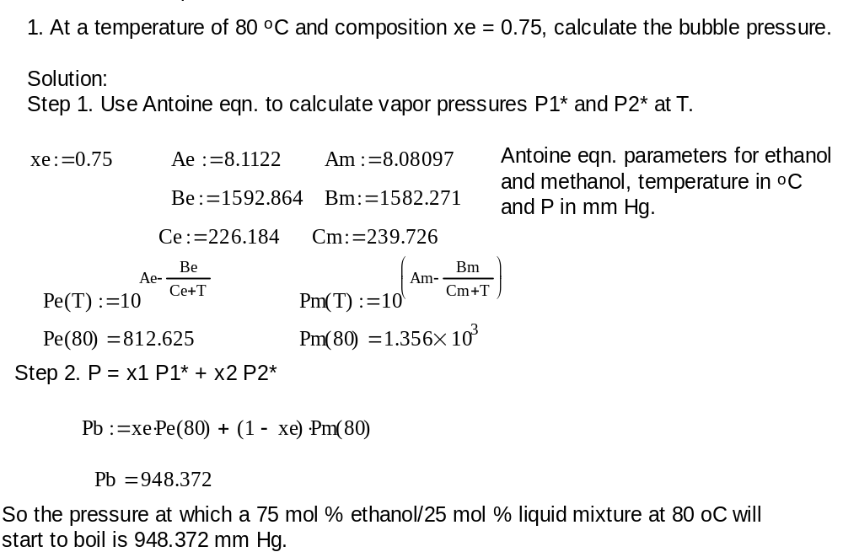

Slide 14
Dew pressure
Given y_{i} and T, calculate the total pressure.
1. Use the Antoine eqn. to calculate vapor pressures P₁* and P₂* at T.
2. P = 1 .
y₁/P₁* + y₂/P₂*
Note that in this situation, P is the pressure at which vapor condenses, i.e. the dew pressure.

Slide 15
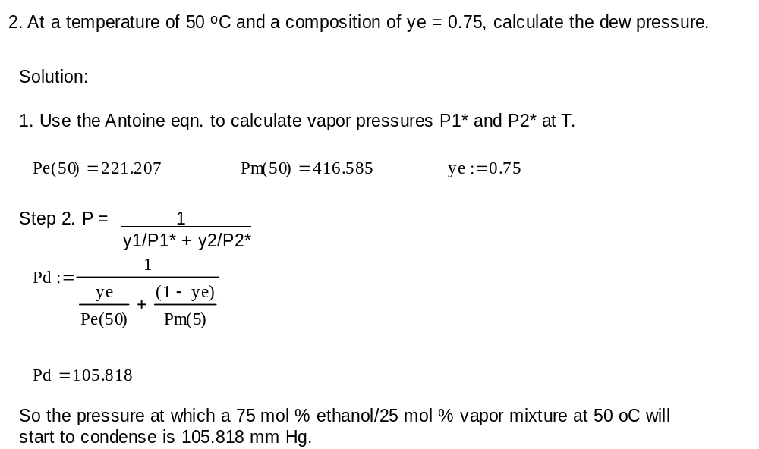

Slide 16
Bubble temperature
Given x_{i} and P, calculate the temperature of the system.
This situation is a bit more involved, as we do not have a simple explicit equation in terms of temperature.
P = x₁ P₁* + x₂ P₂*
Using the Antoine eqn. to calculate vapor pressures,
P = x₁ exp{A₁-B₁/(C₁+T)} + x₂ exp{A₂-B₂/(C2+T)}
This cannot be explicitly solved for T, so an iterative solution is required, i.e. guess T and solve for P until P matches given value.
Note that the value of T obtained here is the temperature at which the liquid first evaporates i.e. the bubble temperature.

Slide 17
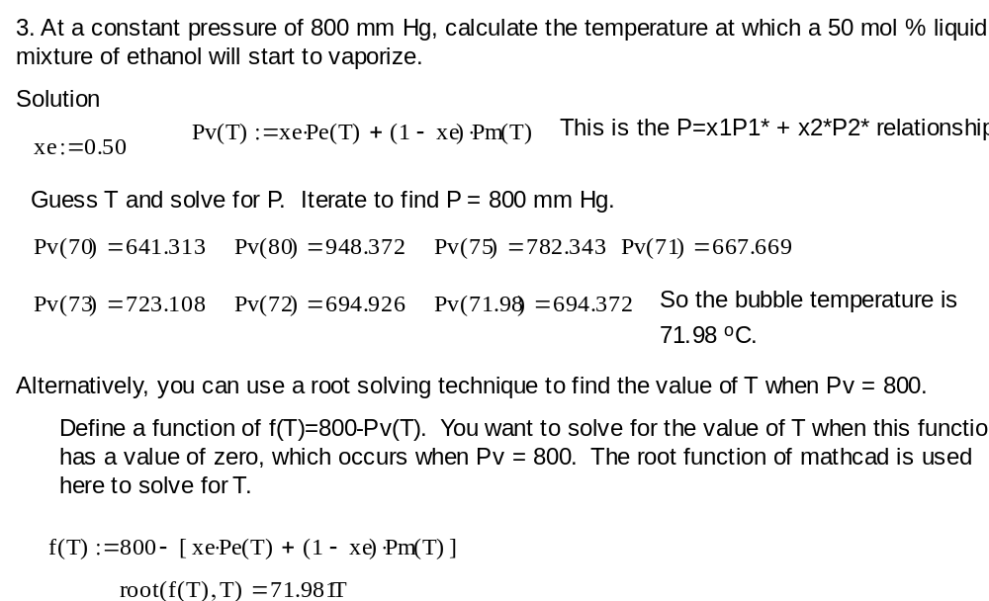

Slide 18
Dew temperature
Given y_{i} and P, calculate the temperature of the system.
This situation is similar to the bubble temperature calculation.
P = 1 .
y₁/P₁* + y₂/P₂*
Using the Antoine eqn. to calculate vapor pressures,
P = 1 .
y₁/ exp{A₁-B₁/(C₁+T)} + y₂/ exp{A₂-B₂/(C₂+T)}
This cannot be explicitly solved for T, so an iterative solution is required, i.e. guess T and solve for P until P matches given value.
Note that the value of T obtained here is the temperature at which the vapor first condenses i.e. the dew temperature.

Slide 19
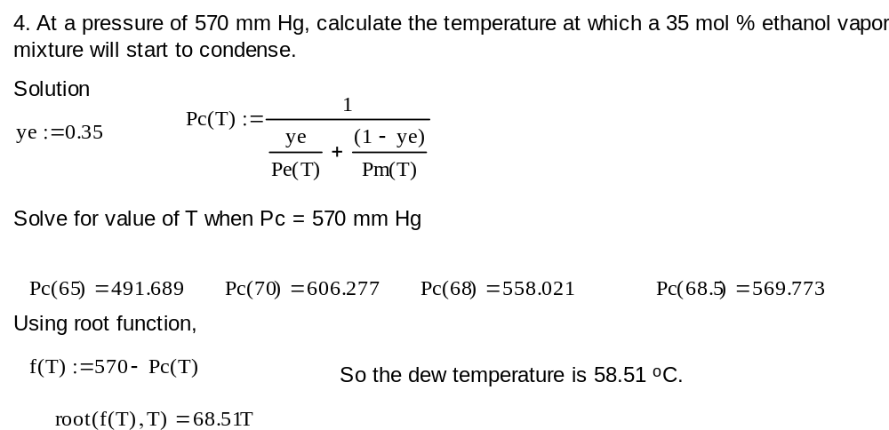

Slide 20
Multicomponent V-L systems
Multi-component systems are modeled the same way as binary systems, except with more than 2 components. The same basic equations apply, i.e.,
P = Σ x_{i} P_{i}*
P = 1/Σ (P_{i}*/ y_{i})
Solution of bubble and dew points are performed the same way as binary systems.

Slide 21
Partition ratio, K_{i}
Another way to look at the V-L equilibrium compositions is the partitioning ratio,
K_{i} = y_{i}/x_{i}
Using Raoult’s law, K_{i} = y_{i}/x_{i} = P_{i}*/P
alternatively, for real binary solutions
K_{i} = y_{i}/x_{i} = φ_{i}* P_{i}*exp{V_{i}^{L} (P-P_{i}*)/RT}/φ_{i} P

Slide 22
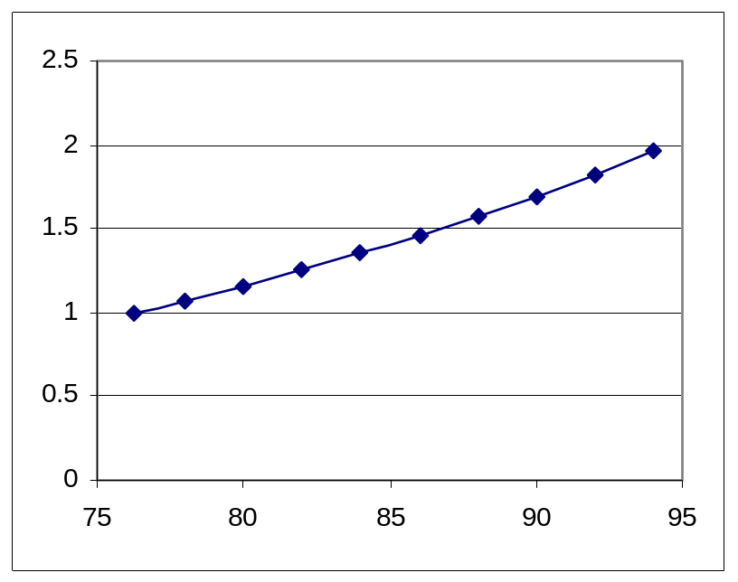
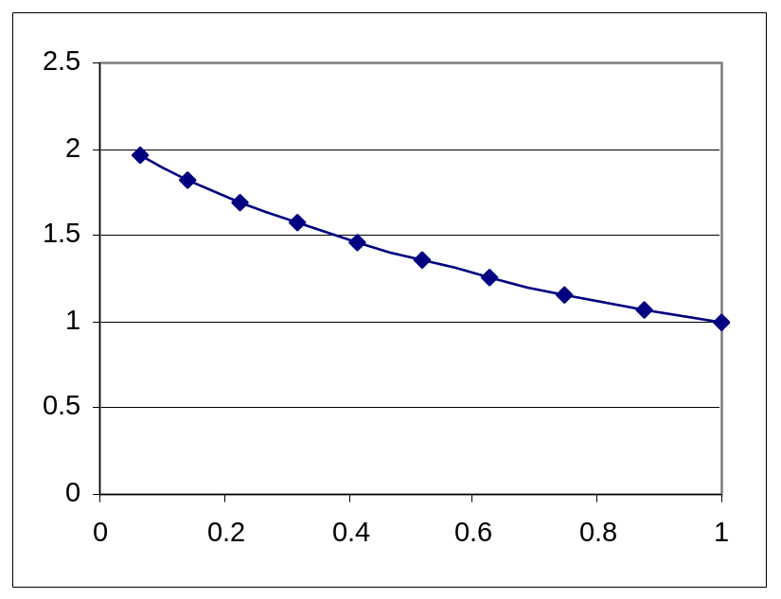
Example: ethanol-propanol binary system
In this system, ethanol has the higher vapor pressure and therefore, the ethanol composition is always higher in the vapor phase than the liquid phase, hence K_{i} is always greater than 1.
Plots of K_{i} vs. temperature and K_{i} vs. composition for ethanol are shown below. Note that K_{i} for ethanol rises with temperature, but falls with increasing liquid ethanol composition. Also note that the minimum value of K_{i} for ethanol is 1.
K_{i}
K_{i}
T
x_{e}

Slide 23
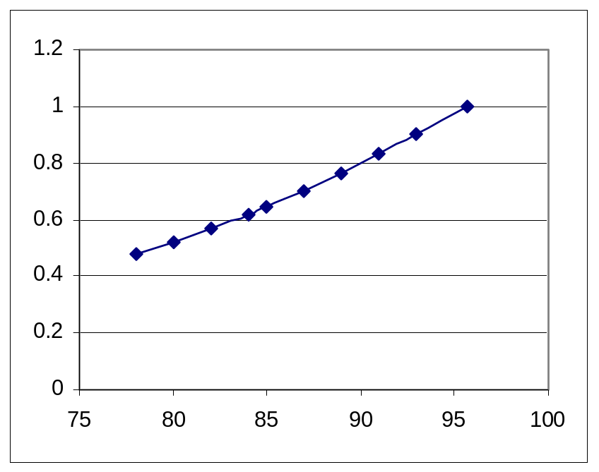
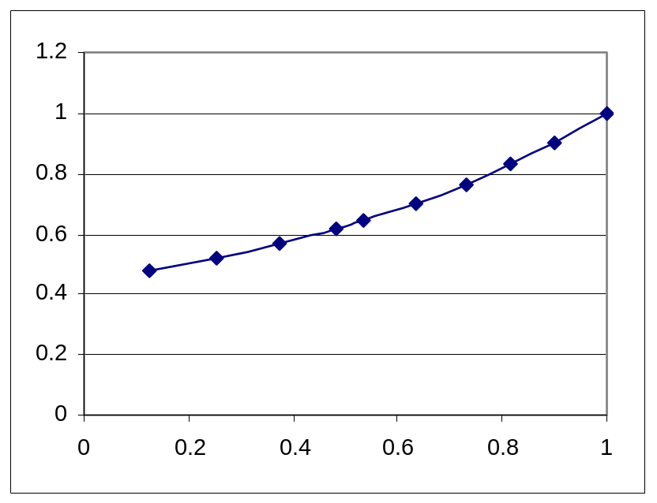
Example: ethanol-propanol binary system
If the K_{i} values for propanol (lower vapor pressure) are plotted, the maximum value of K_{i} is 1.
However, note that K_{i} rises with both temperature and propanol liquid composition.
K_{i}
K_{i}
T
x_{p}

Slide 24
Modified Raoult’s Law
Recall that equilibrium requires that
f_{i}^{V} = f_{i}^{L}
Given the definitions of real solutions, using the Poynting correction for liquids,
f_{i}^{V} = φ_{i} y_{i} P
f_{i}^{L} = γ_{i} x_{i} f_{i}^{L} = γ_{i} x_{i} φ_{i}* P_{i}* exp{V_{i}^{L} (P-P_{i}*)/RT}
substituing these into to the equilibrium condition,
φ_{i} y_{i} P = γ_{i} x_{i} φ_{i}* P_{i}* exp{V_{i}^{L} (P-P_{i}*)/RT}
Making the assumptions that the Poynting correction factor and ratio of fugacity coefficients are unity, gives
y_{i} P = γ_{i} x_{i} P_{i}*
This is called the modified Raoult’s law. The addition of the activity coefficient provides a more realistic solution model.

